Slide 1
Student Information GUI

Slide 2
Interfaces to be used
ActionListener : for button events
ItemListener : for choices events

Slide 3
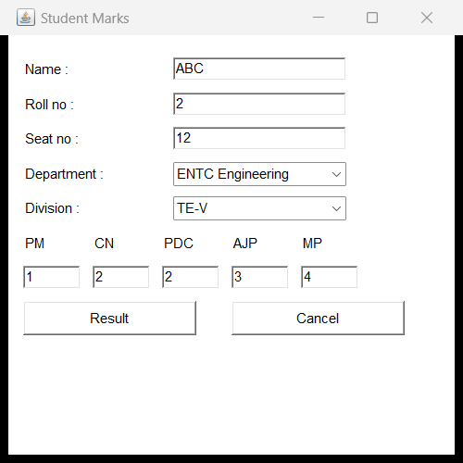
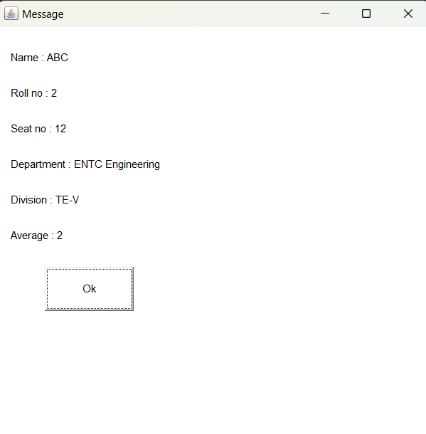
Output

